Slide 1
EENG 284 Lab 2
Hexadecimal to 7-segment converter
Notes:
Usually the <title of the lab> is what will be called the “System” through the rest of this document

Slide 2
Lab Objectives
Learn how the always/case statement implements truth tables.
How to combine bits into vectors.
How to download synthesized code the development boards.

Slide 3
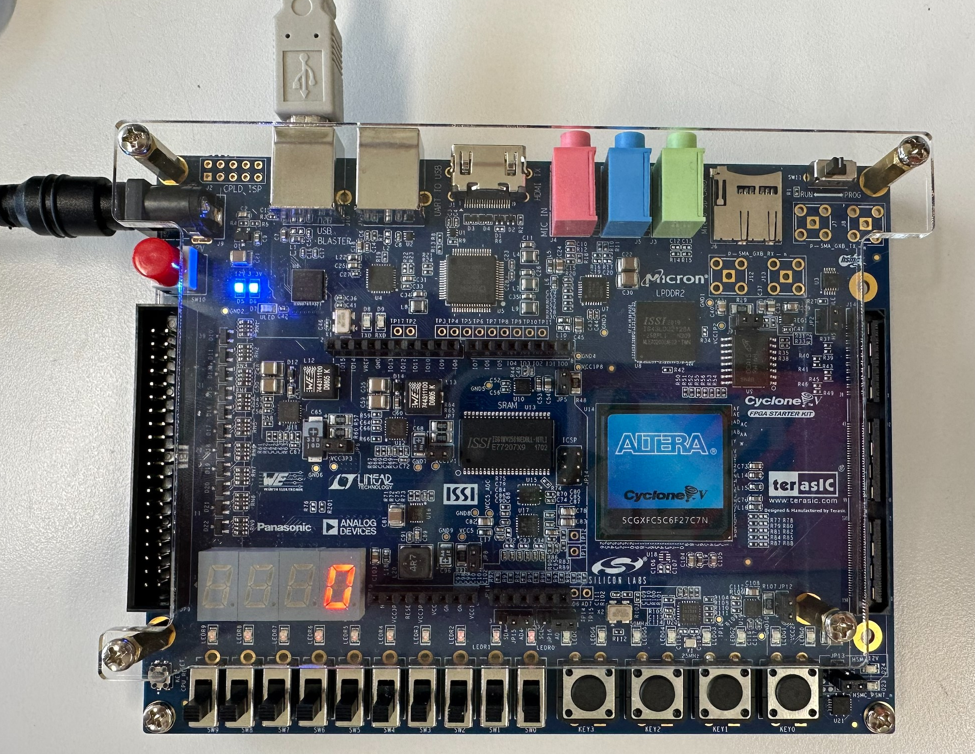
Cyclone V GX Board
Field Programmable Gate Array (FPGA)
Cyclone V GX
User Inputs
4 push buttons
10 toggle switches
Outputs
10 red LEDs
8 green LEDs
4 7-segment displays

Slide 4
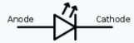
7-segment Display
Consists of 7 active low light emitting diodes (LEDs)
LEDs light up when you send them logic 0
LEDs turn off when you send them logic 1
Illuminated to form characters 0-F
Notes:
A light-emitting diode (LED) is a semiconductor light source that emits light when current flows through it.

Slide 5
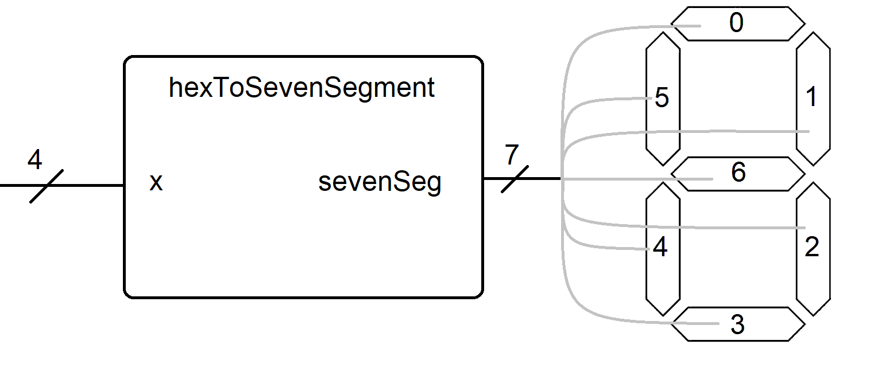
Hexadecimal to 7-segment converter
Input: 4-bit hexadecimal value (from slide switches)
Output: Pattern to illumination hex character
Notes:
Replace <System> with the name of the

Slide 6
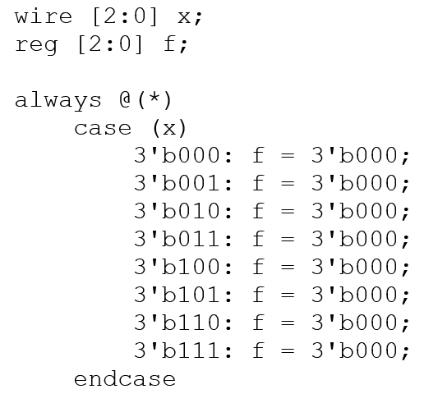
Verilog: Always/Case statements
Implement truth tables
always @(*)
always/case is always running
case (x)
x is the input variable – usually a vector
List of values of input are on left
Output in right
Pretty boring function

Slide 7
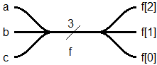
Verilog: Vectors
Define a vector f
wire [2:0] f;
Assign a value using concatenation of 1-bit values
assign f = {a, b, c}; // a is MSB
Assign a value using a 3-bit vector
assign f = 3’b101;
Access a bit of a 3-bit vector. Indexed starting at 0
assign y = f[2]; // MSB of f vector
Notes:
Talk about the input is transformed into the output using the system architecture

Slide 8
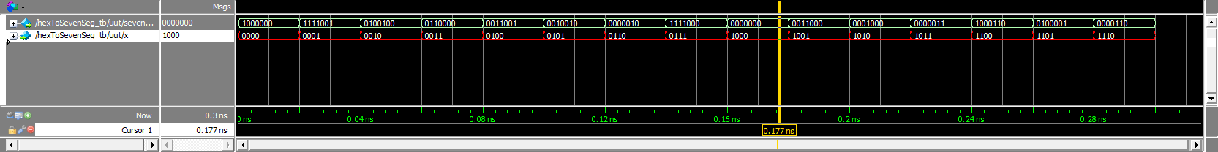
Simulation
Perform simulation
Checks for syntax errors
Ensure hex2SevenSeg works

Slide 9
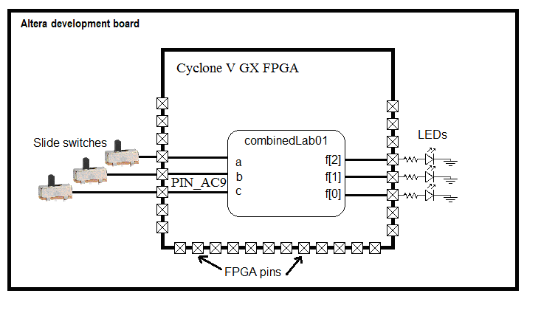
Synthesis
Converts Verilog to Cyclone V GX fabric
Create association between
hex2SevenSeg ports
FPGA pins
FPGA pins are connected to Cyclone V GX inputs and outputs
Use Cyclone V GX User Manual
Find I/O device
Find letter/number code for cyclone pin

Slide 10
Deliverables
Part 1:
Truth Table for combinedLab01 function
Timing diagram for combinedLab01 function
Pin assignment for combinedLab01
Part 2:
Truth Table for hexToSevenSeg function
Verilog code for hexToSevenSeg function – just the always/case statement
Simulation timing diagram for hexToSevenSeg function
Pin assignment for hexToSevenSeg
Demonstrate operation of hexToSevenSeg in lab

